Slide 1
CSNE Testbeds
04/10/13

Slide 2
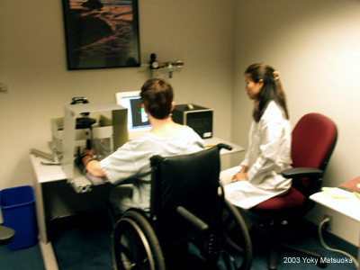
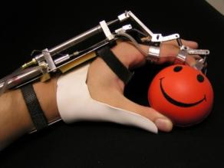
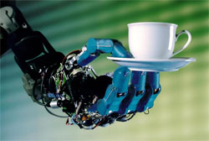
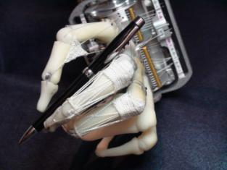
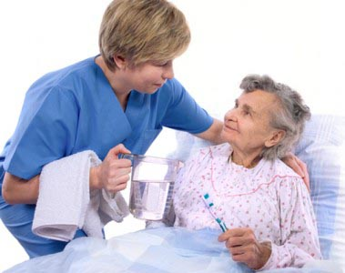
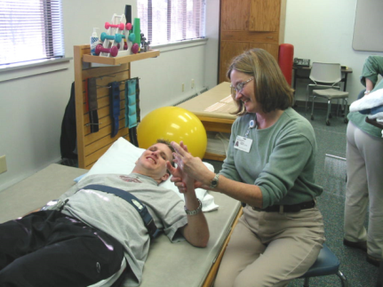
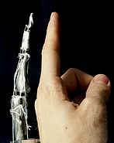
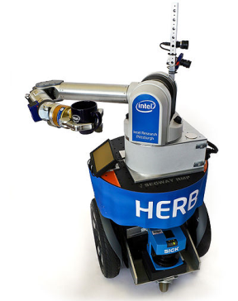
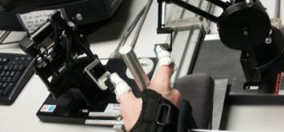
Retraining (T2) Augmentation (T1) Remote Assistance (T3)
Robotic Rehabilitation
Home-Based Therapy
Dexterous Prosthetics
Exoskeleton
Home-Based Assistance

Slide 3
Testbed #1
1) Closed-loop Prosthetic Limbs: The center is developing “smart” lower extremity prostheses that provide haptic feedback to the user and dynamically adjust to the terrain underfoot and the state of the user’s residual limb. Proposals that advance the state of the art in sensing, neural feedback strategies, or detection of user intent and conversion to control of powered prostheses are encouraged.

Slide 4
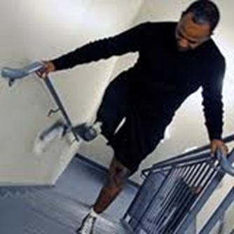
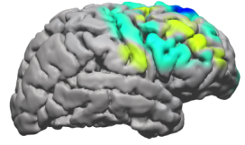
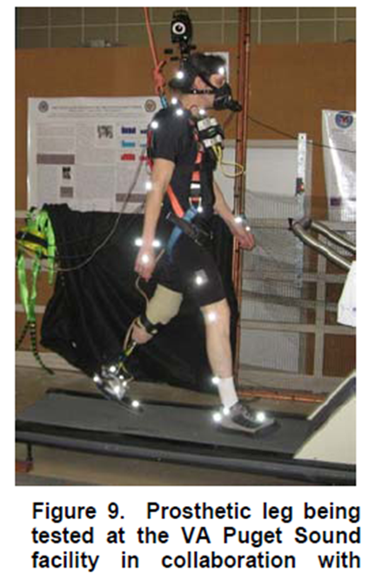
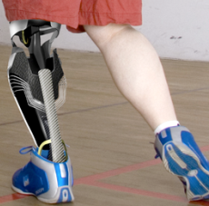
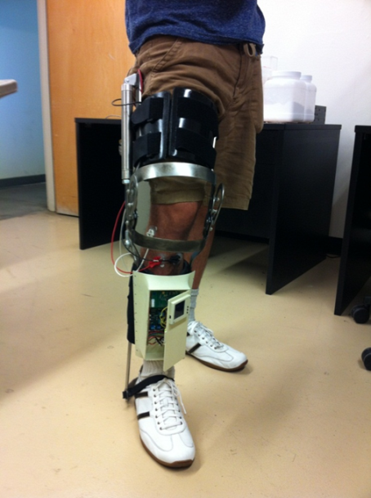
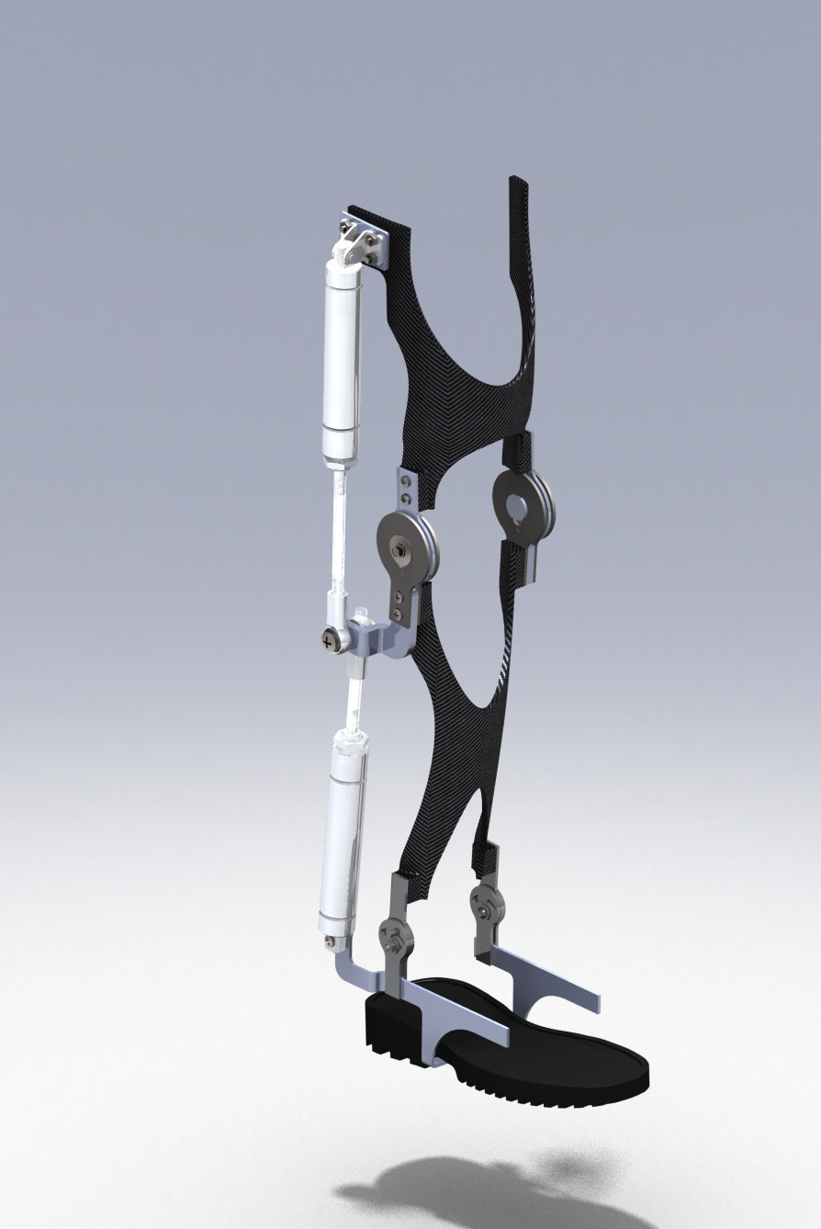
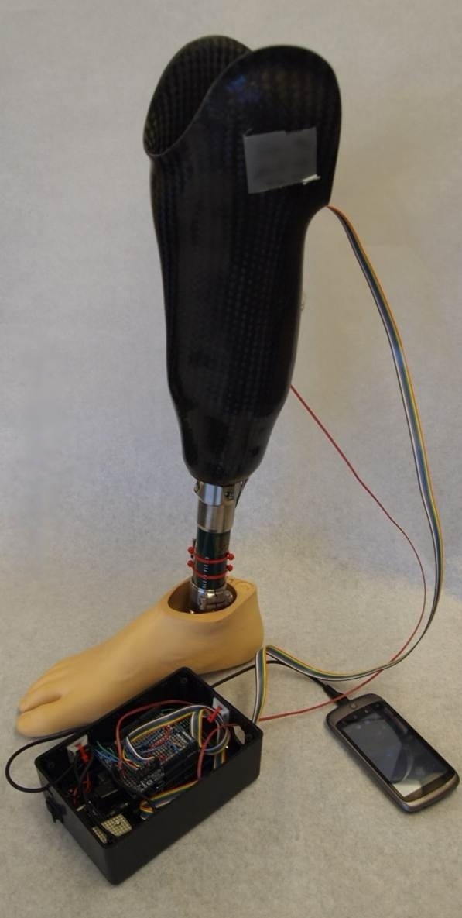
Neuro-adaptive Robotic Limbs
Neural Adaptive Prosthetic Legs
Brain Adaptation
Spinal Cord
Neural Interface
Nerves
Sensory Feedback
x
Control
Algorithms
Prosthetic Limb

Slide 5
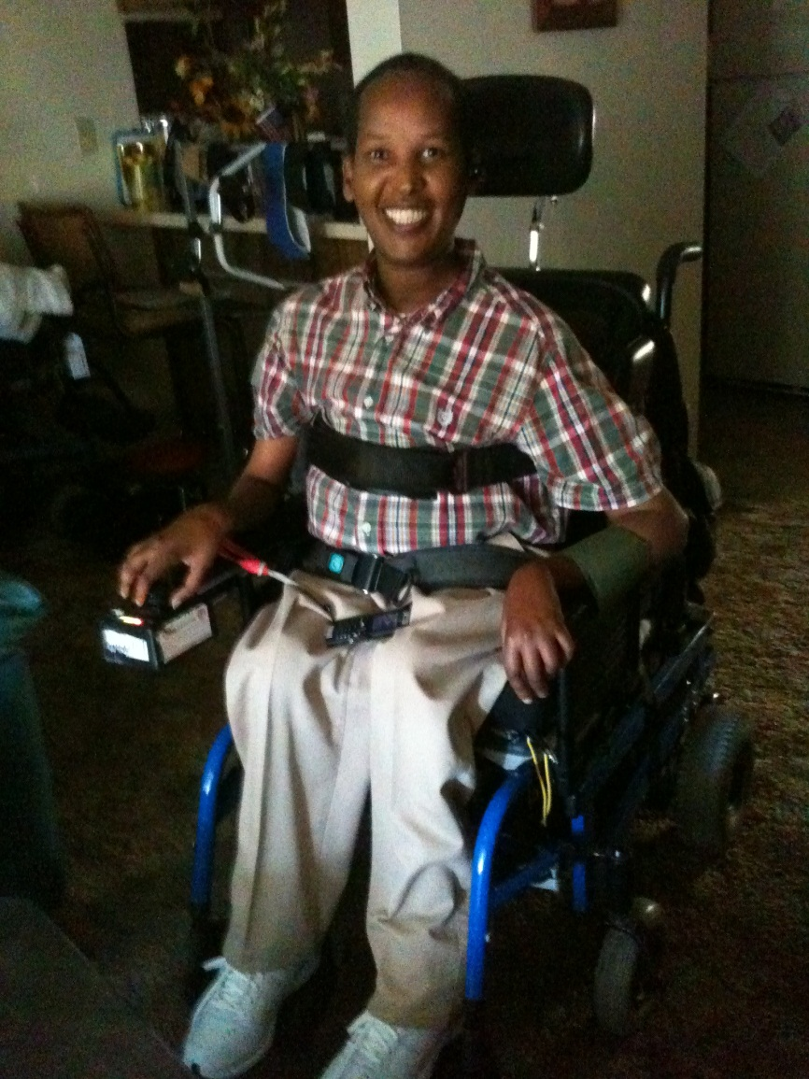
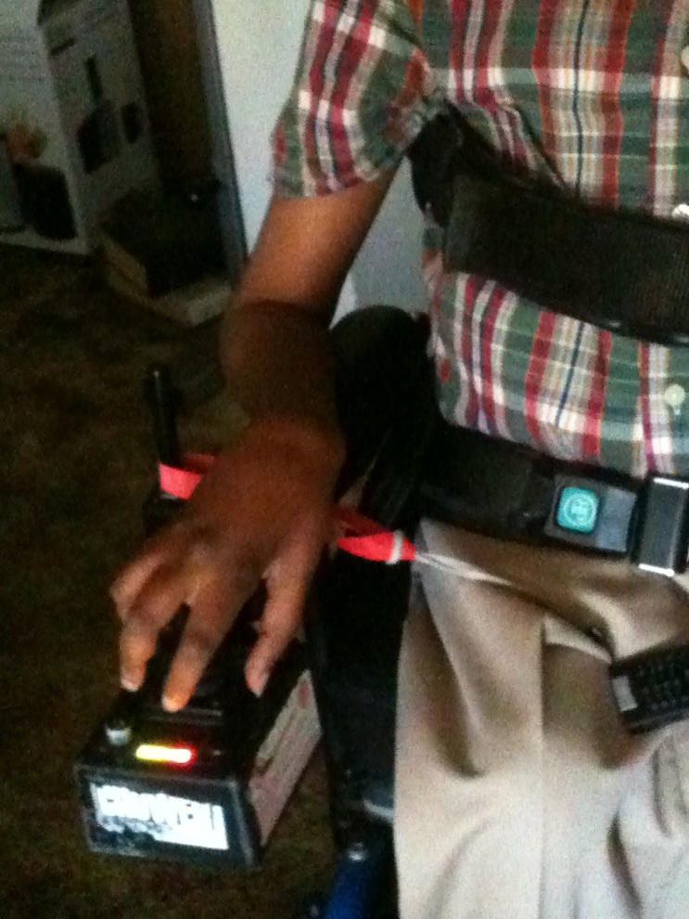
Mr. Jama suffered polio as a child and recovered most of his function following the illness. However, ~30 years later, he has experienced a decline in neuromuscular function. He is in a wheelchair and has been progressively losing strength in his arm muscles. He contacted us in July to request assistance with moving his arms so that he can control his wheelchair joystick and self-feed/drink. He does not wish to try rehabilitation or physical therapy but instead would rather have an assistive device for his arm.

Slide 6
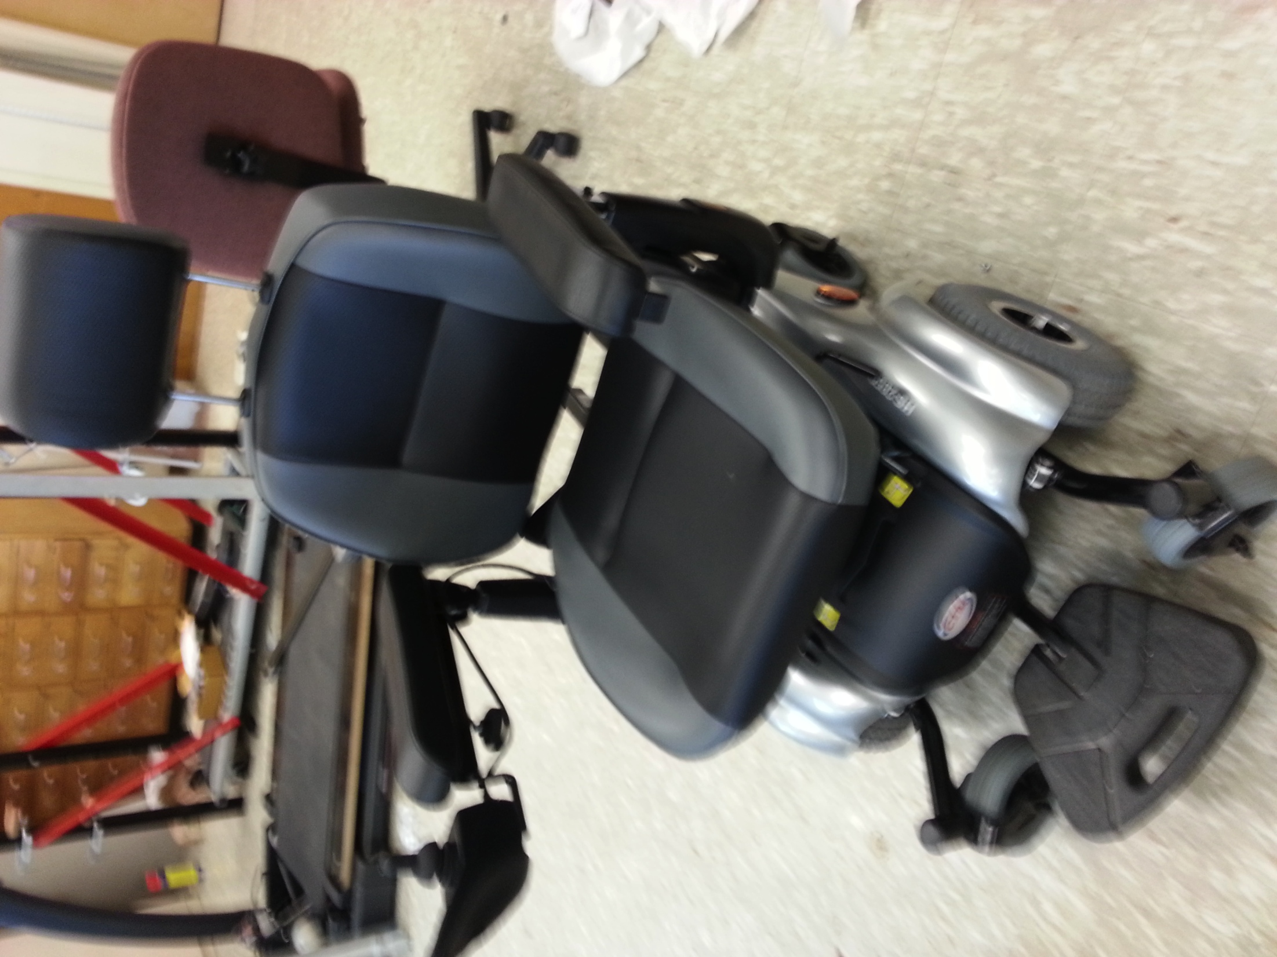
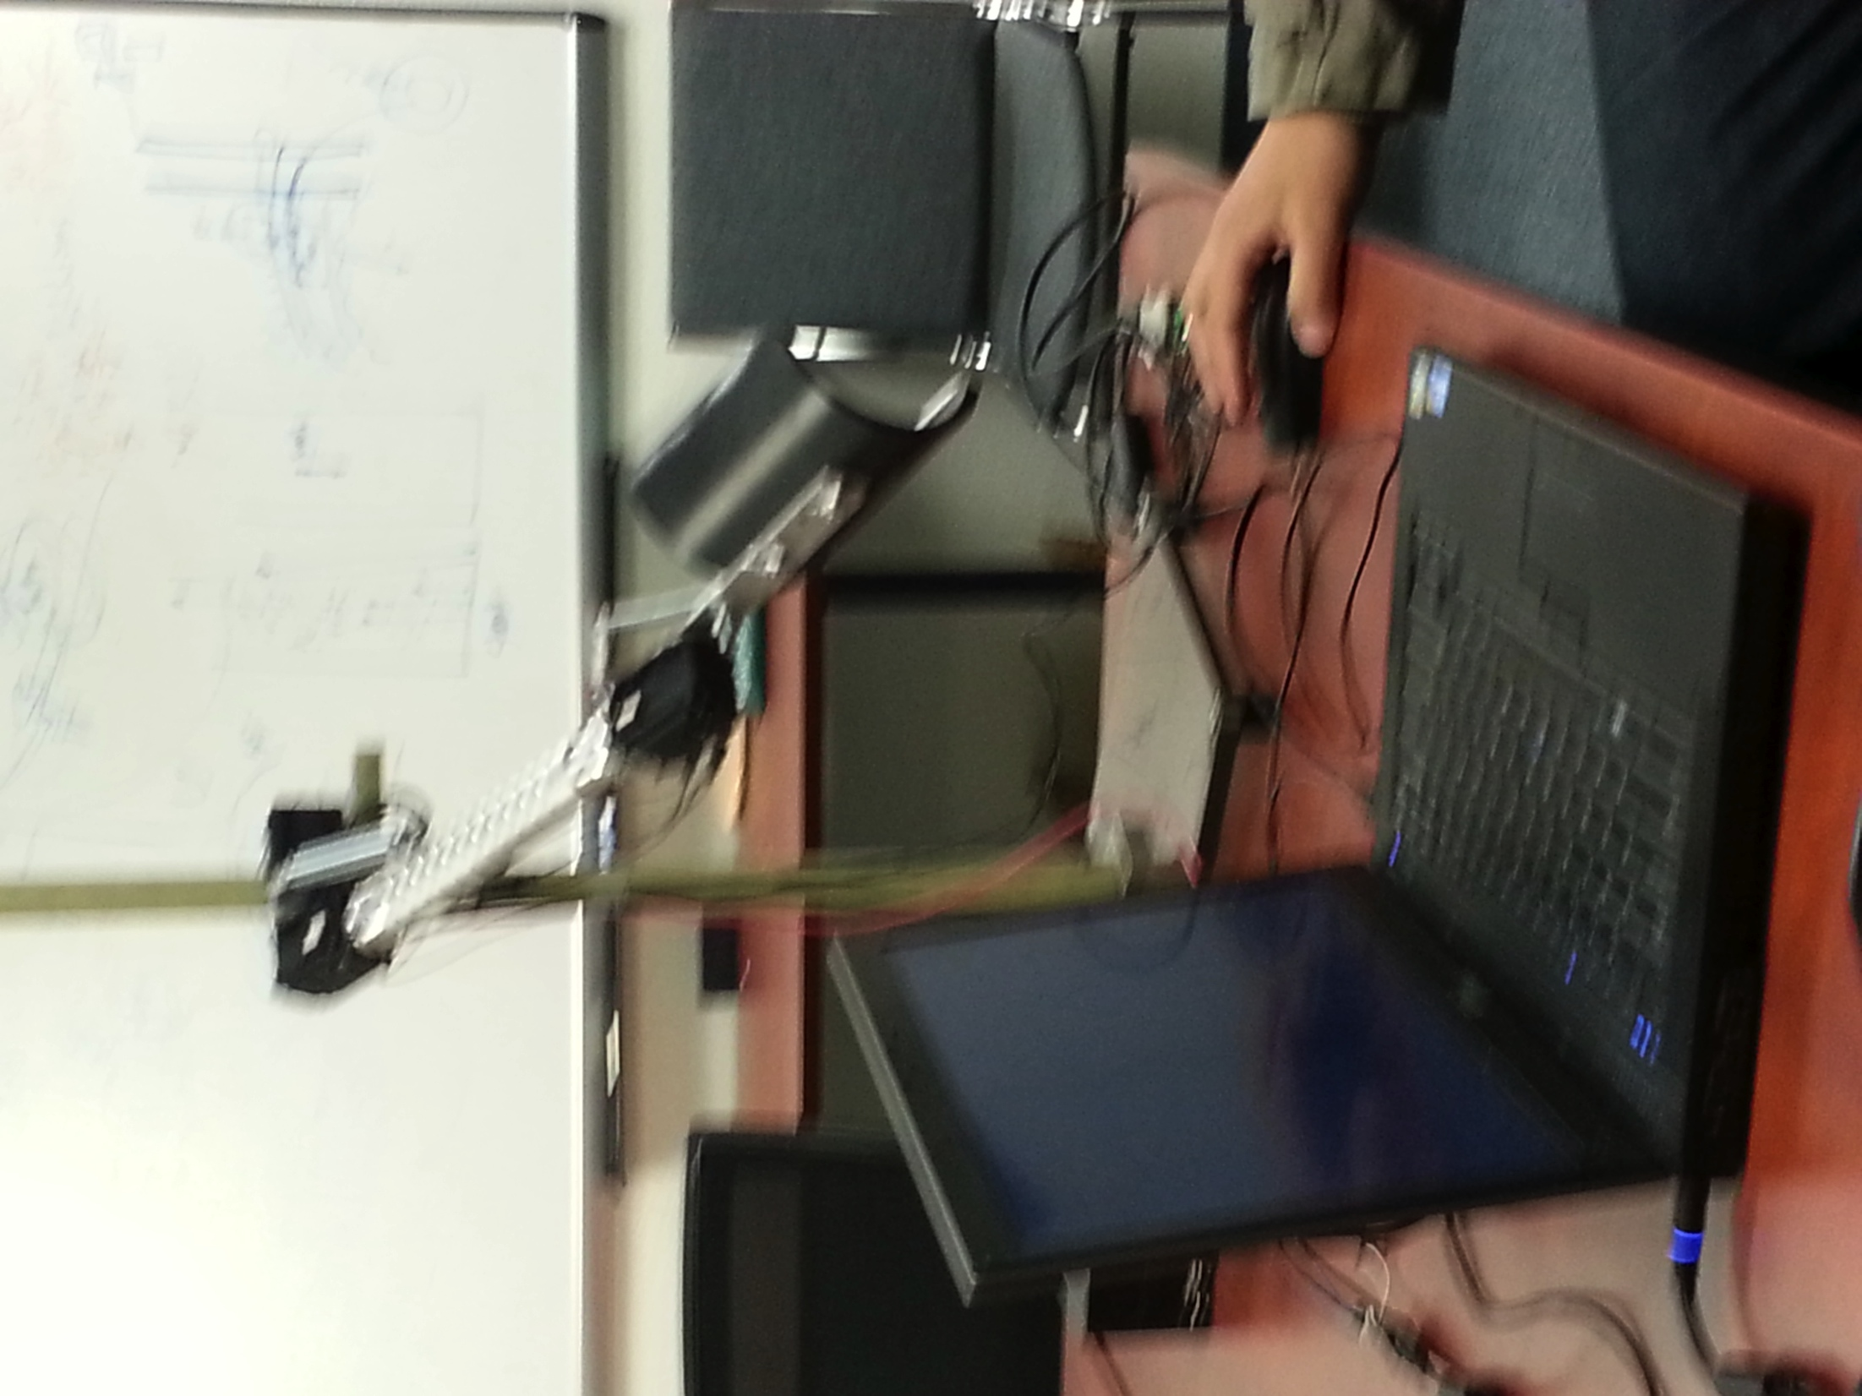

Slide 7
Testbed #2
2) Neuro-rehabilitation Systems: The center is developing rehabilitation systems to improve function of the nervous system after injury or disease. Examples include EMG-driven computer games for rehabilitation of movement after brain injury, or augmented sensory feedback environments for users with impaired sensation. Proposals that advance neural signal sensing or sensory feedback technologies, human-computer interaction, and therapy strategies that leverage neuroplasticity to improve function are encouraged.

Slide 8
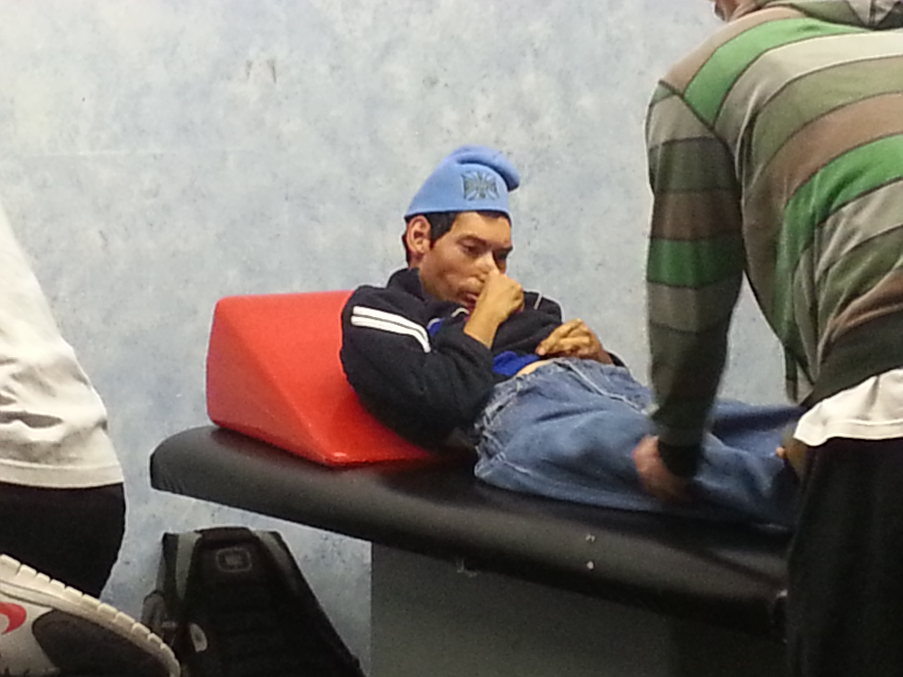
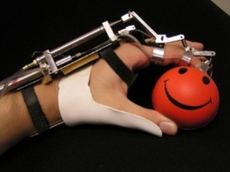
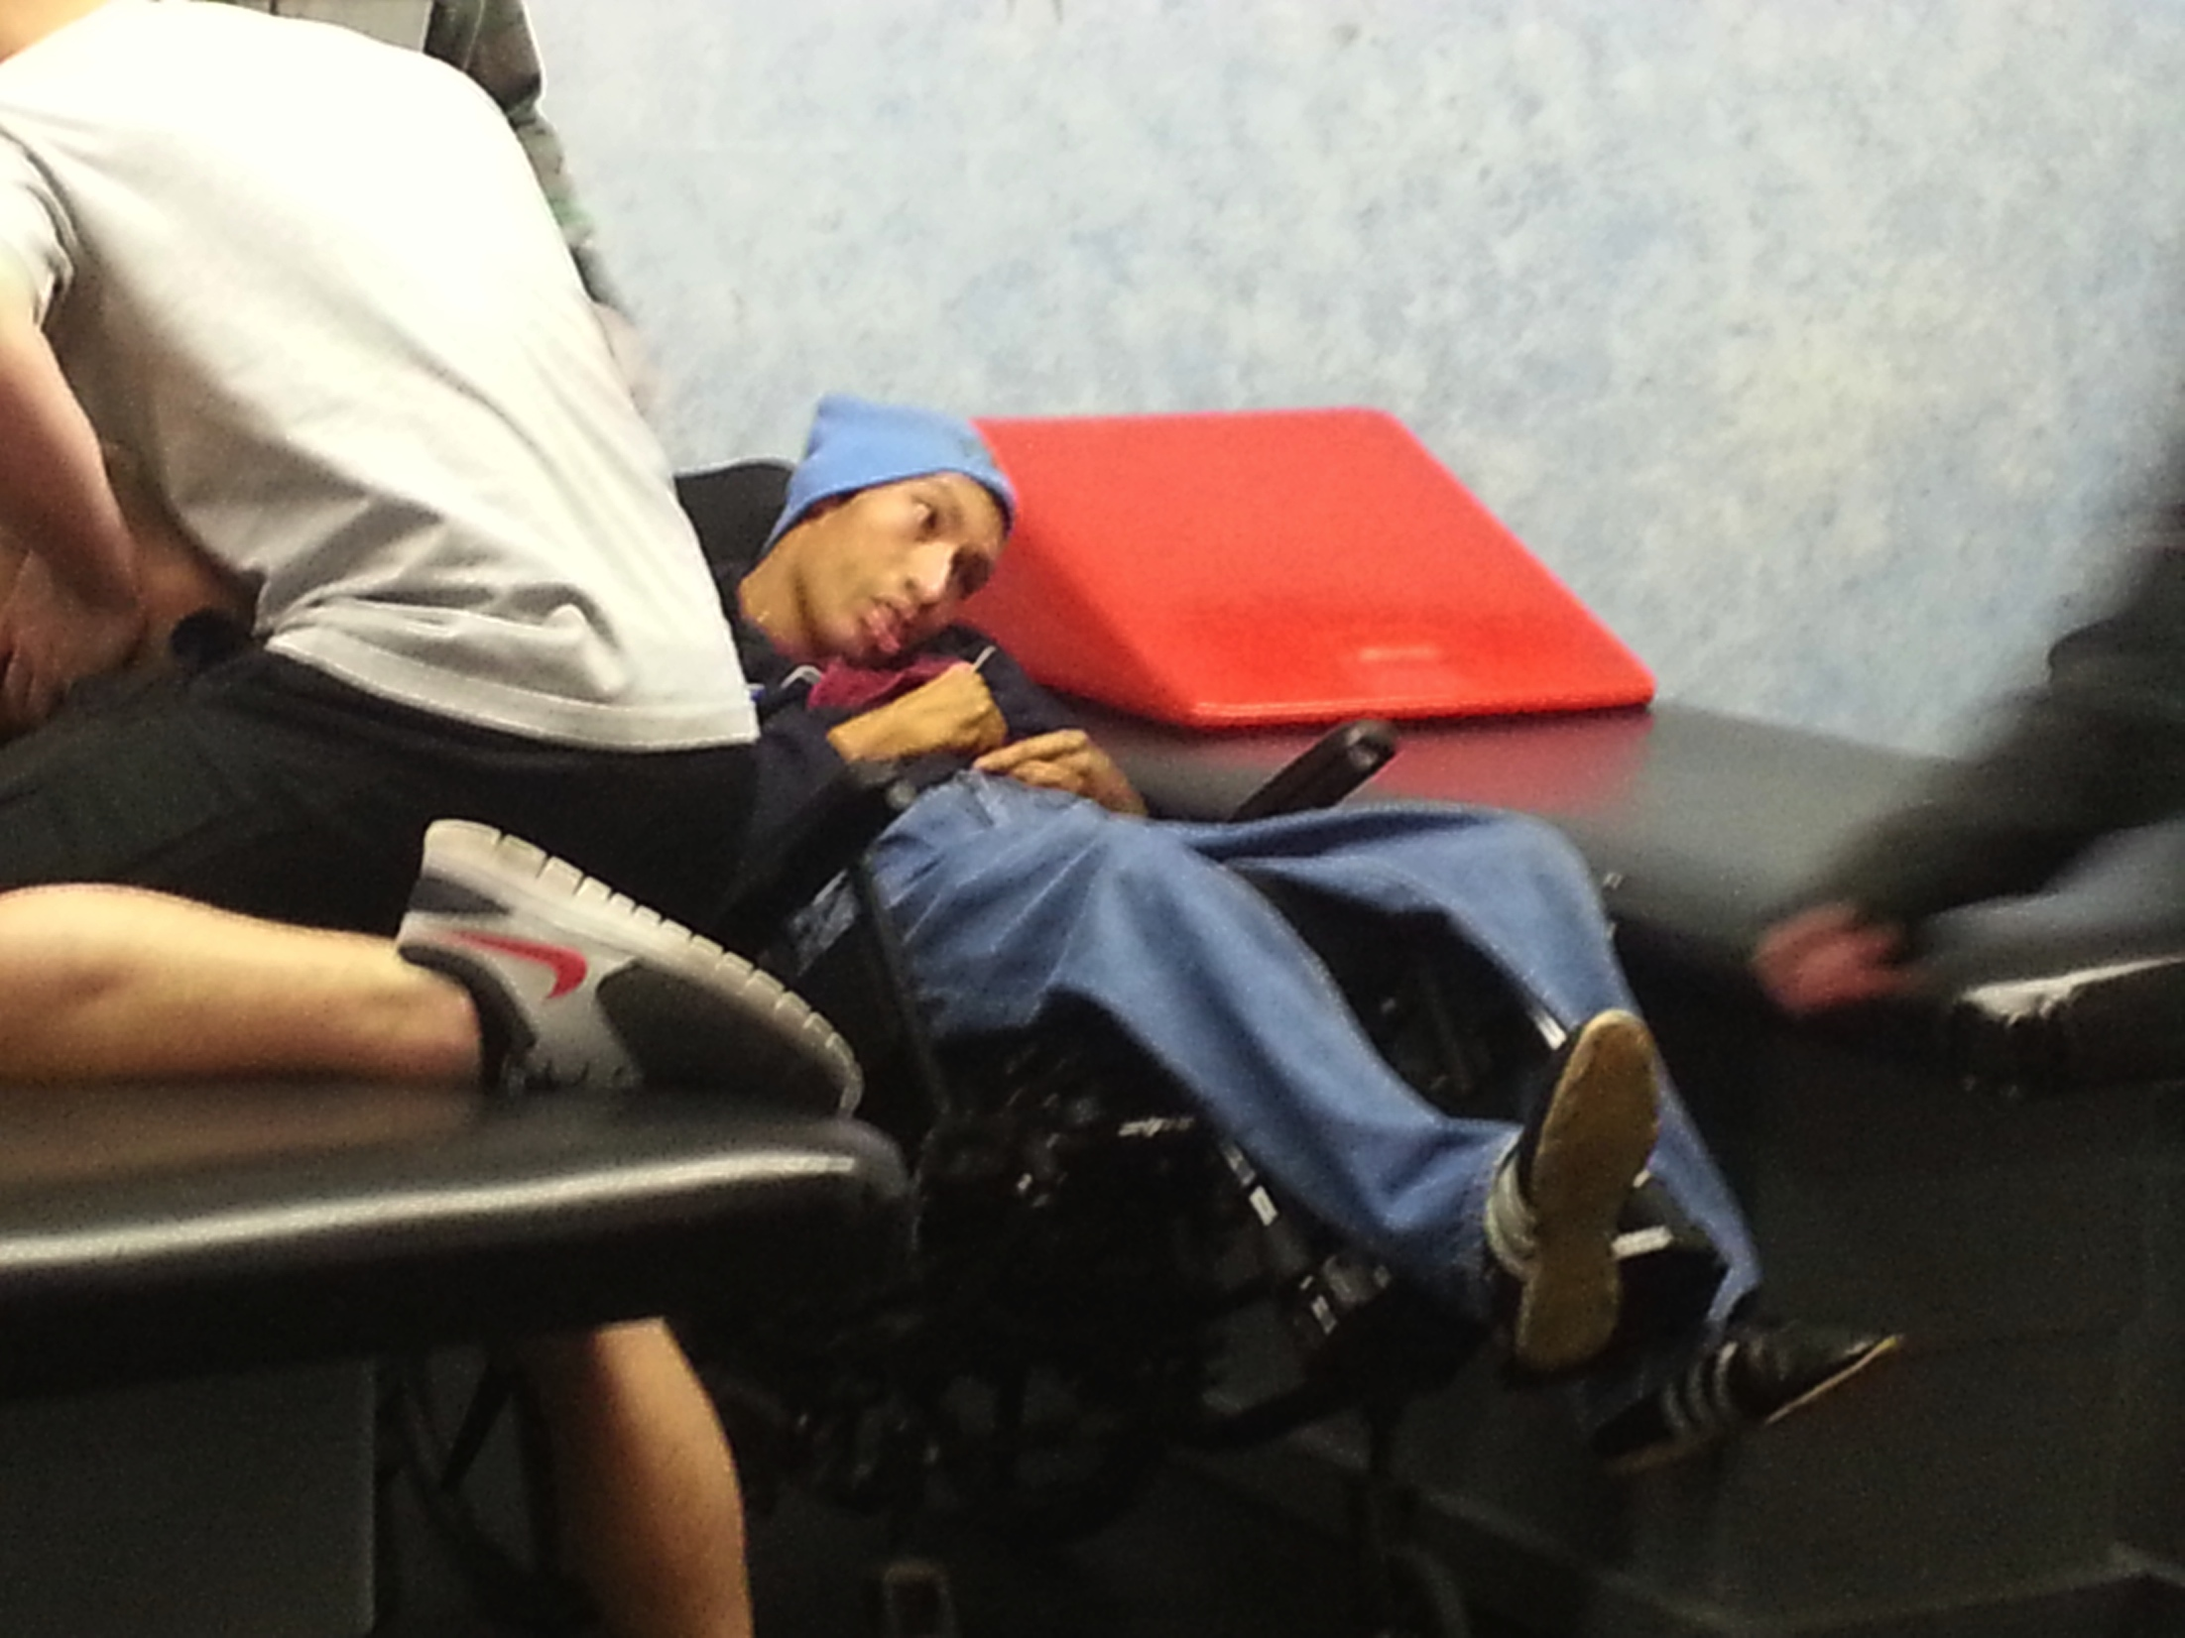
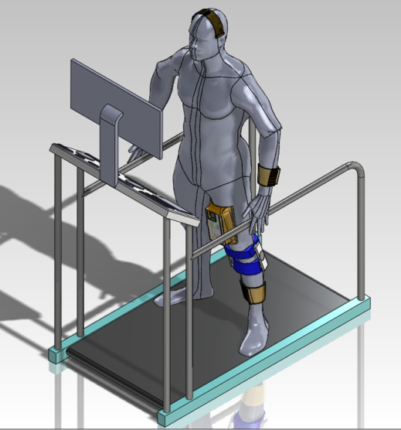
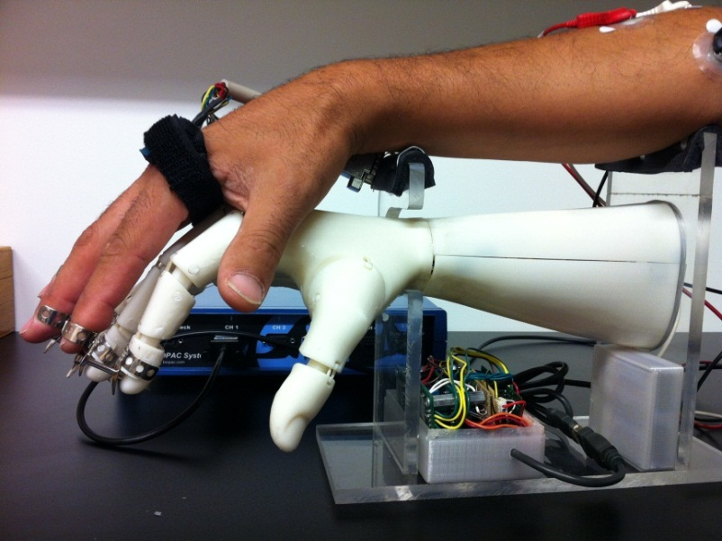
Neuro-Rehabilitation Systems
NeuroGame Rehabilitation
Home-Based NeuroRehabilitation
Brain Adaptation
x
Spinal Cord
Sensory Feedback
Neural Interface
Nerves
Control
Algorithms
Robotic Interface

Slide 9
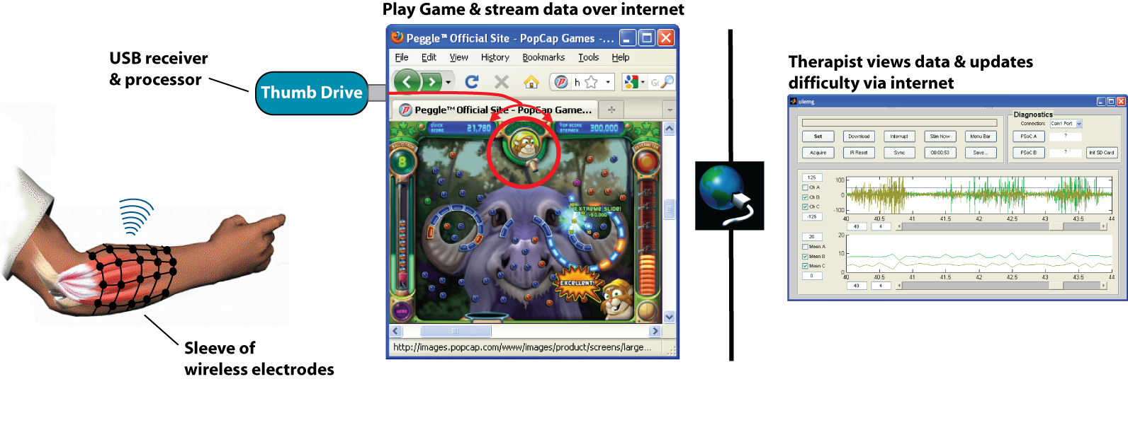
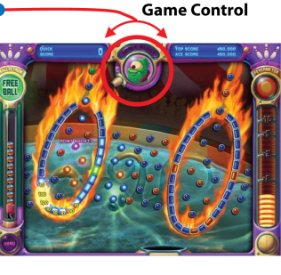
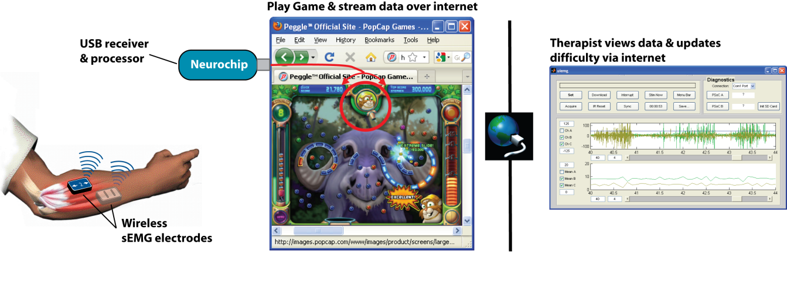
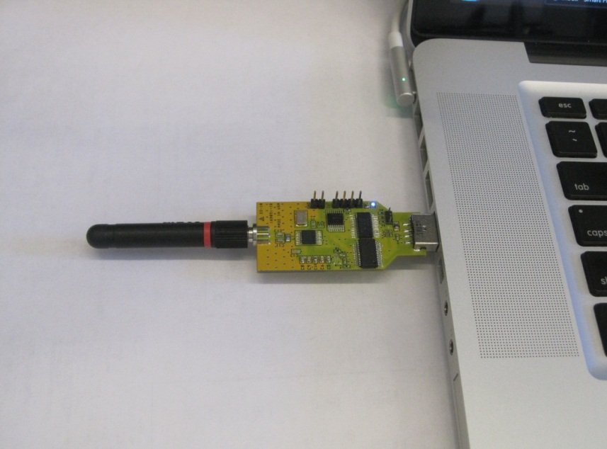
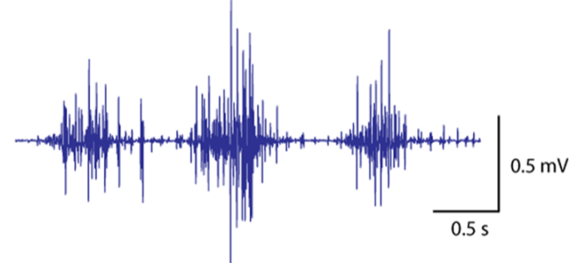
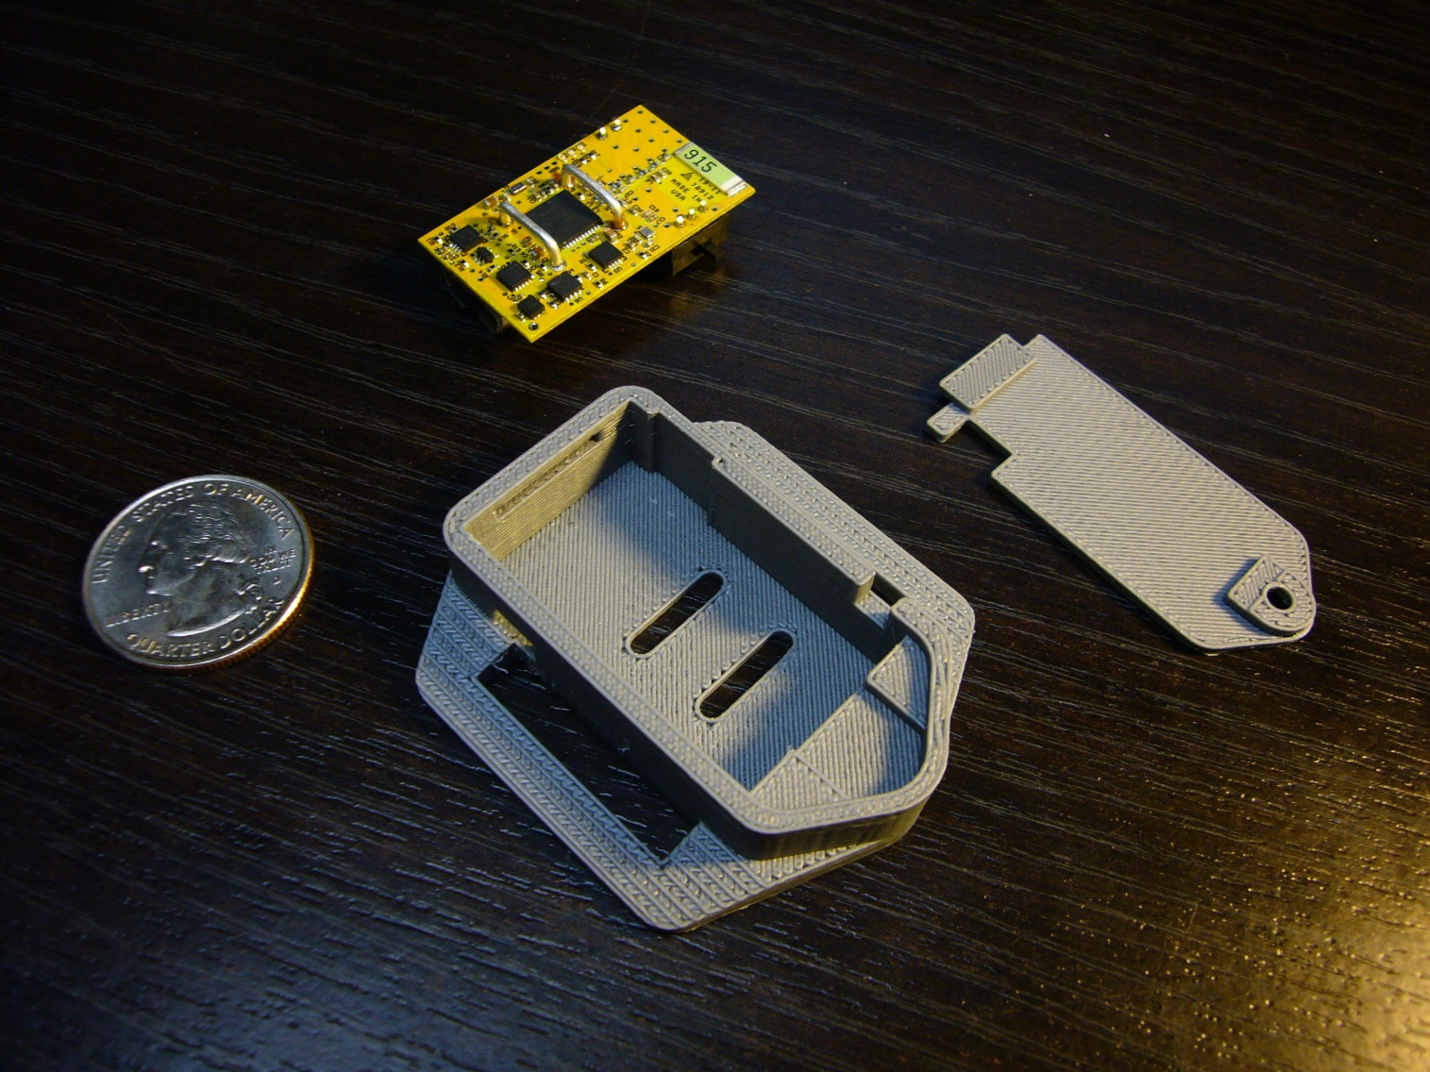
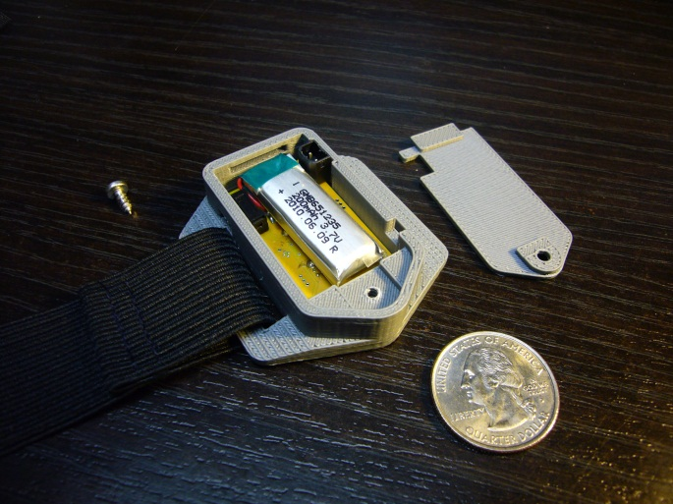
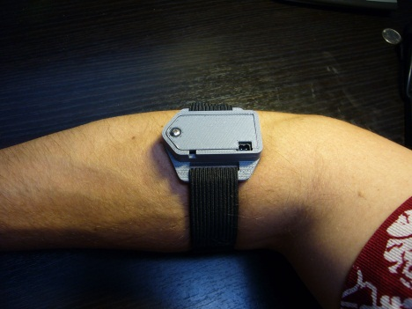
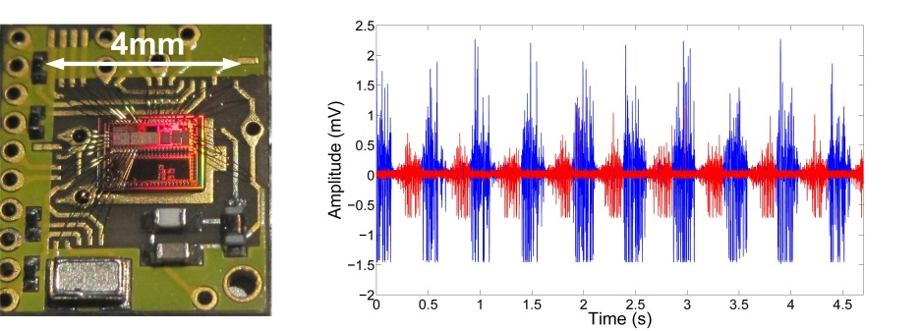
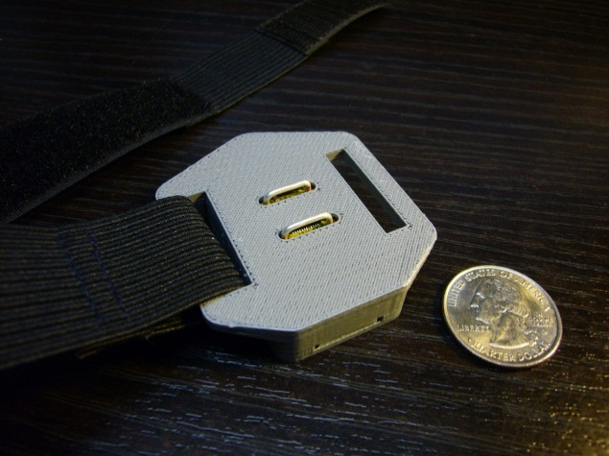
Wireless body-worn sensors
USB receiver & processor
Wireless EMG transmitter
Notes:
9
{skip if short on time}
To improve ease of use (and the ‘coolness factor’ for the kids), Brian’s team has created low-cost wireless EMG electrodes.
--- They designed circuits populated with off the shelf components, to digitize and transmit EMG, and fit easily inside small electrode housings.
The subjects need only to slip on a strap with sensors over the muscles of interest before playing the game.
--- Brian’s group has also created a USB ‘thumb drive’ to receive and process the wireless EMG signal.
Thus, the entire system fits in the palm of your hand, and can be used with any computer.
--- Although we initially validated this system with the Bumblebee, Brian’s ultra-low power custom CMOS circuit with a very efficient radio, we have chosen to use COTS components to keep the system cost down and make it accessible to a larger population of patients.
[Trans]: We have also recently deployed web-enabled software to provide a remote link between the patient and physical therapist.

Slide 10
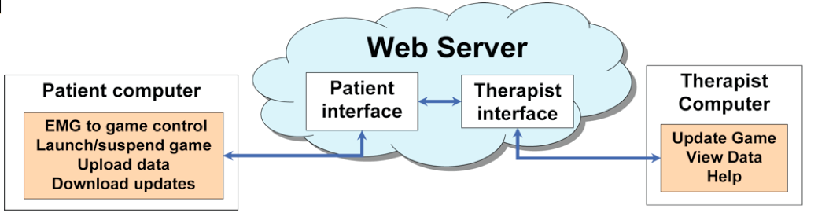

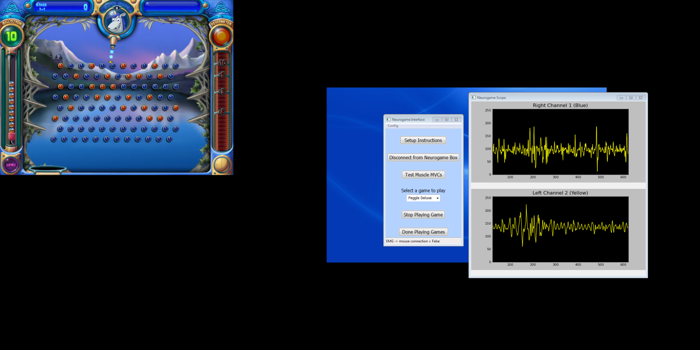

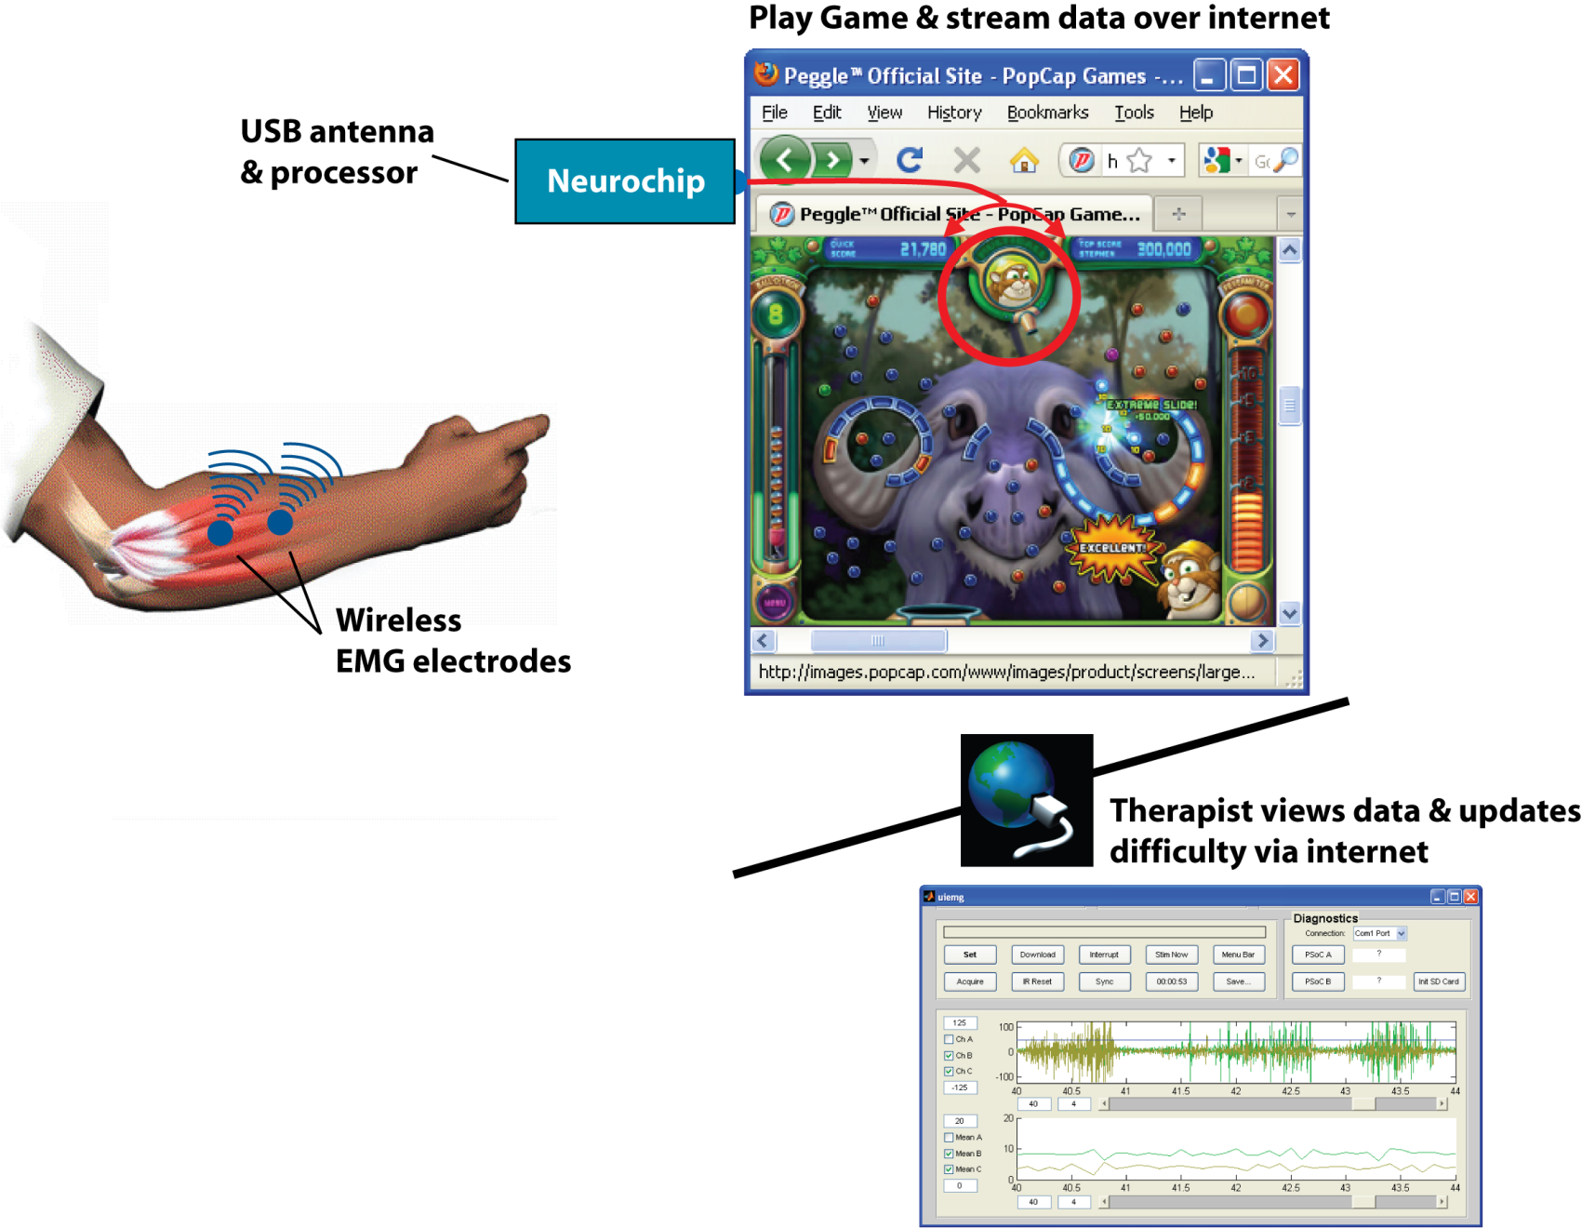
Cloud-based home therapy software
Web-connected game interface and EMG data streaming to server permits clinician to view data and update difficulty remotely
Notes:
10
{skip if short on time}
This cloud-based software facilitates interaction between the patient at home and the therapist in their clinic.
--- A simple user interface allows the patient to perform test sequences and launch specific EMG-controlled games chosen for their therapy goals.
--- Therapists can review game play and muscle activity data, and upload changes to the therapy program game or difficulty.
This allows the therapist to review the patient’s performance remotely, and eliminates the need for costly home or clinical visits.
[Concl:] We are excited about the potential of this NeuroGame therapy to improve motor function following brain injury. We are currently in the middle of testing a group of 10 subject recovering from stroke, and we are in the process of beginning to test this intervention for people with incomplete spinal cord as well as lower-extremity impairments.
[trans]: To summarize the three neural engineering approaches I’ve described today…

Slide 11
Testbed #3
3) Closed-loop Brain-controlled Interfaces: The center is focused on developing brain-controlled interfaces that assist individuals with movement impairments. Examples include remote assistive devices controlled by brain signals, and closed-loop systems were sensory information or motor intent is routed back into the nervous system via stimulation. Proposals that advance our ability to reliably record signals originating from the brain, extract useful control commands in real-time, and actuate an external device or deliver functional stimulation to the sensorimotor system are encouraged.

Slide 12
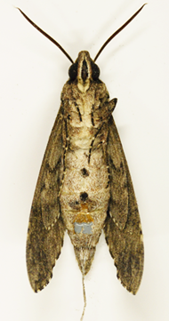
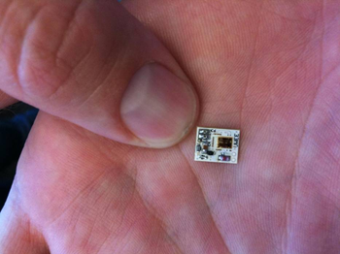
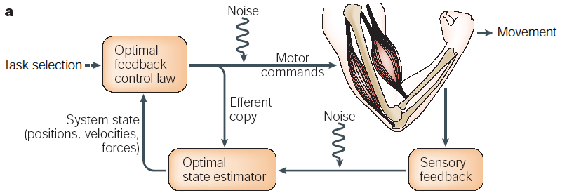
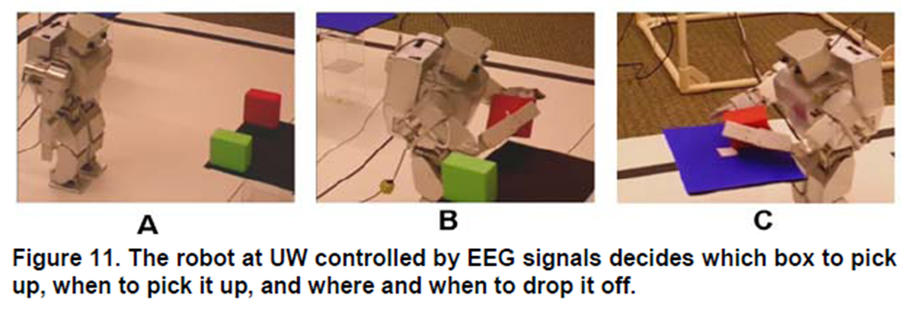
Closed-loop Brain-controlled Interfaces
Paralyzed Arm/Hand Reanimation
Neural Interface
Brain Adaptation
x
Spinal Cord
Functional Electrical Stimulator
Nerves
Sensory Feedback
Control
Algorithms

Slide 13
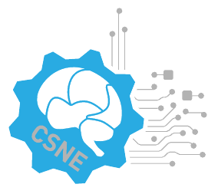

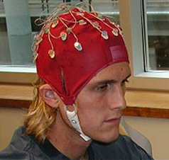
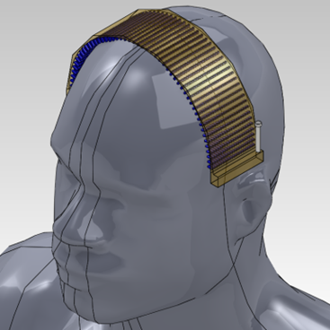
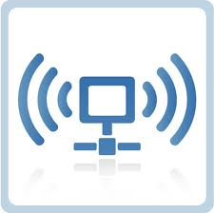
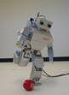
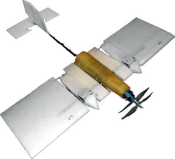
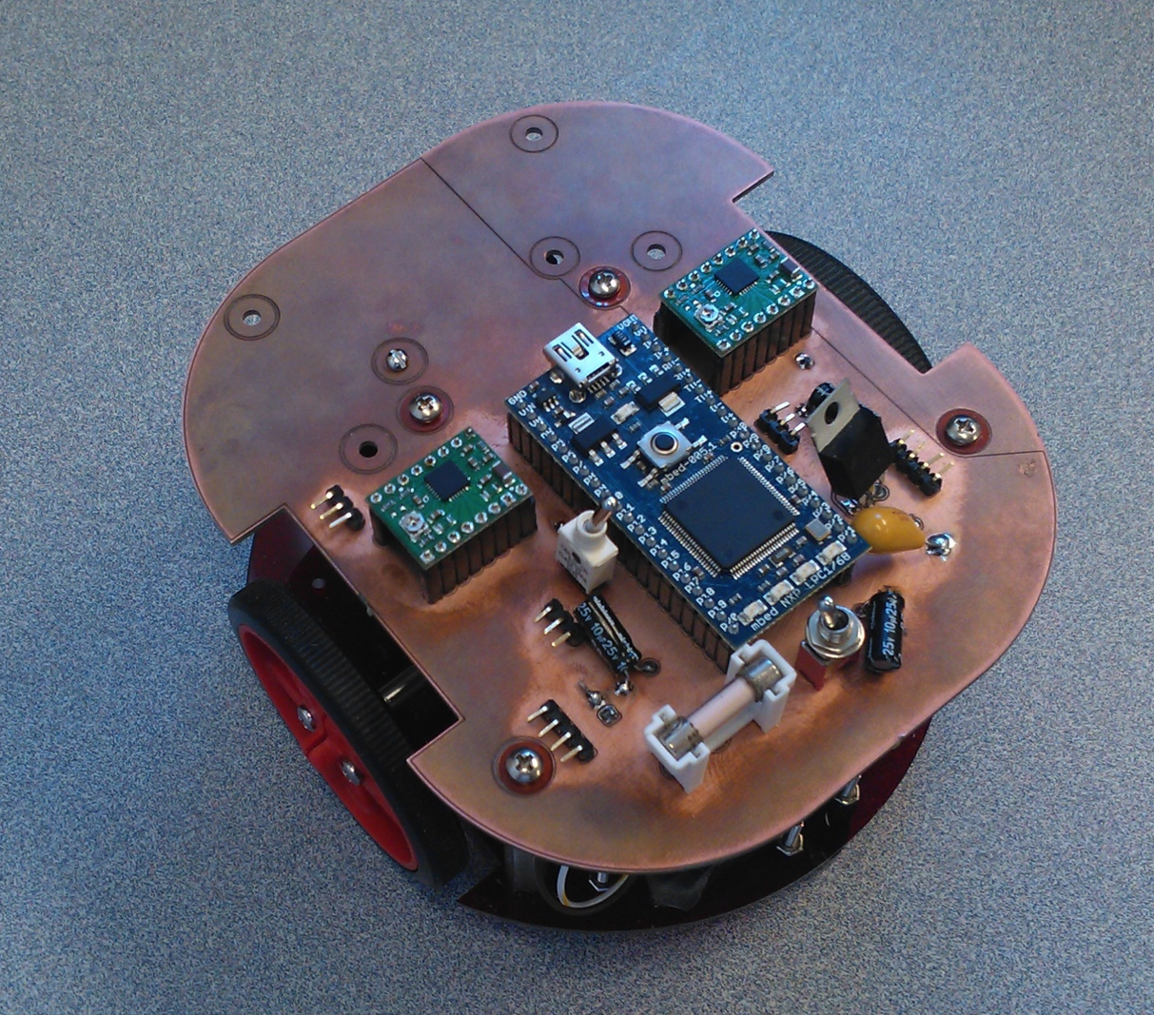
Center for Sensorimotor Neural Engineering
Remote assistive systems
USER
Feedback to user via combined sensory input
Neural signal translation
WIRELESS TRANSMISSION
Data return from system
SDSU Mobile EEG
Robust control of remote assistive system
Morphy humanoid robot
Agile flight
Wheeled vehicle

